Slide 1



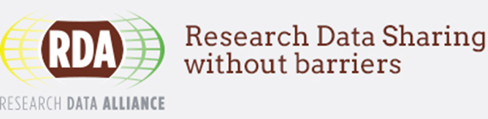
Data as an infrastructure: CDS, the Virtual Observatory, astronomy, and beyond
Françoise Genova
Présenté par
Notes:
<number>

Slide 2
Sharing scientific data – Open science
A « hot » topic, up to the political agenda
G8 Science Ministers
  Strong statements on Open Scientific Research Data, 13 June 2013
https://www.gov.uk/government/news/g8-science-ministers-statement
  Global Research Infrastructures include data sharing aspects, 9 October 2015, Berlin
http://www.g8.utoronto.ca/science/2015-berlin.html#gris
  Open Science – Entering a new era for science, 17 May 2016, Tsukuba
http://www.g8.utoronto.ca/science/2016-tsukuba.html
6 June 2017
F. Genova, LISA VIII, Strasbourg
<number>
Notes:
<number>

Slide 3
The June 2013 G8 Set of principles
i. To the greatest extent and with the fewest constraints possible publicly funded scientific research data should be open, while at the same time respecting concerns in relation to privacy, safety, security and commercial interests, whilst acknowledging the legitimate concerns of private partners.
ii. Open scientific research data should be easily discoverable, accessible, assessable, intelligible, useable, and wherever possible interoperable to specific quality standards.
iii. To maximise the value that can be realised from data, the mechanisms for delivering open scientific research data should be efficient and cost effective, and consistent with the potential benefits.
iv. To ensure successful adoption by scientific communities, open scientific research data principles will need to be underpinned by an appropriate policy environment, including recognition of researchers fulfilling these principles, and appropriate digital infrastructure.
6 June 2017
F. Genova, LISA VIII, Strasbourg
<number>

Slide 4
Additional G8 Ministers’ statements
Following a report of the « Group of Senior Officials on Global Research Infrastructures » (GSO) (Oct. 2015)
  Further progress on sharing and managing scientific data and information should be achieved, especially by continuing engagement with community based activities such as the Research Data Alliance RDA.
  We encourage the GSO to continue their work on convergence and alignment of inter-operable data management that could accomplish an effective open-data science environment at the G7 level and beyond.
Open Science statement – Entering into a new era for science (May 2016)
  Establish a working group on open science with the aims of sharing open science policies, exploring supportive incentive structures, and identifying good practices for promoting increasing access to the results of publicly funded research, including scientific data and publications, coordinating as appropriate with the Organisation for Economic Co-operation and Development (OECD) and Research Data Alliance (RDA), and other relevant groups; and
  Promote international coordination and collaboration to develop the appropriate technology, infrastructure, including digital networks, and human resources for the effective utilization of open science for the benefit of all.
6 June 2017
F. Genova, LISA VIII, Strasbourg
<number>

Slide 5
Recent advances
The FAIR Guiding Principles for scientific data management – Findable, Accessible, Interoperable, Reusable – already present in astronomy for a looooooong time
http://www.nature.com/articles/sdata201618
Rapid emergence of the Research Data Alliance (RDA)
https://www.rd-alliance.org
6 June 2017
F. Genova, LISA VIII, Strasbourg
<number>
Notes:
<number>

Slide 6
Not only a political subject!
A change in paradigm in the way science is done
Astronomy was a pioneer and can be taken as a case study
In astronomy data is available AND USED!
  More papers from data retrieved from HST archives than from original observations
  800.000 queries/day in average on the CDS services alone (only one element of landscape)
  etc
6 June 2017
F. Genova, LISA VIII, Strasbourg
<number>

Slide 7
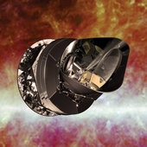

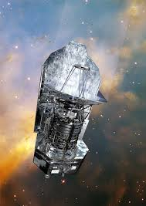
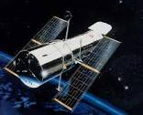
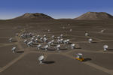

Astronomy Research Infrastructures
And data!
6 June 2017
F. Genova, LISA VIII, Strasbourg
<number>

Slide 8
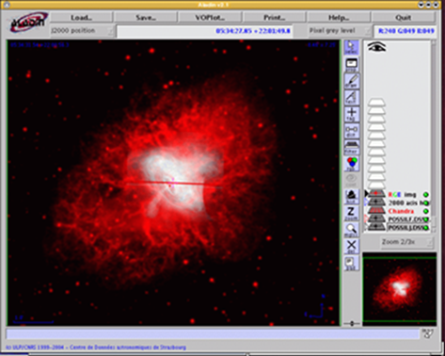
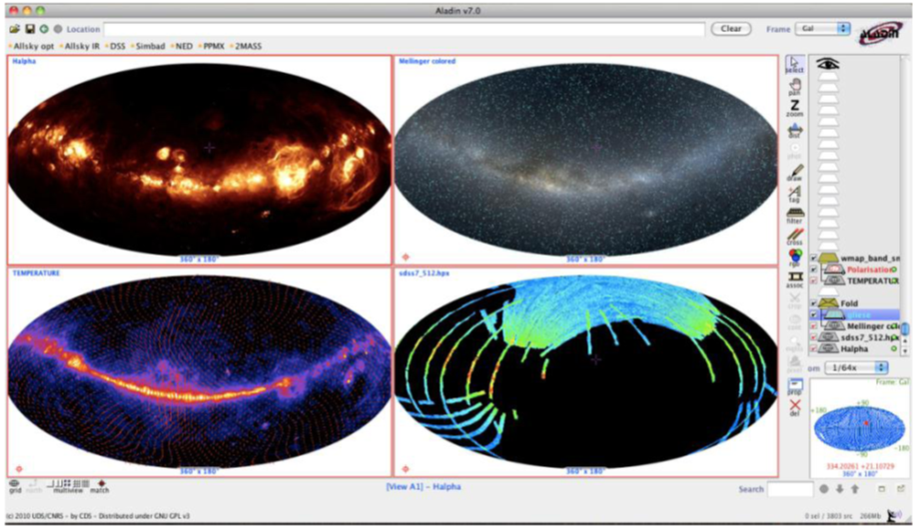
Why sharing data?
At the core of astronomy scientific needs !
Multi-wavelengths, multi-technique astronomy
Time variability
Comparison of theoretical models with observations
Etc.
Optimize the scientific return of the large infrastructures
6 June 2017
F. Genova, LISA VIII, Strasbourg
<number>

Slide 9
How? Basic elements
A common data format since the 70s (FITS)
Strong tradition of international collaboration
Open data in general (often after a proprietary period)
Driven by community needs (on-line observation archives, on-line services)
6 June 2017
F. Genova, LISA VIII, Strasbourg
<number>

Slide 10
Astronomical data
  Observations from ground- and space based telescopes (in general competitive calls for proposals)
  Sky surveys (homogeneous data set with up to billions of objects, measurements, images, spectra, time series)
  Modelling results
  Data from publications
  Value-added data bases, which gather homogenized information in particular from publications
e.g. SIMBAD, names of objects and papers in which the object is cited:
9 200 000 objects, 24 700 000 object names, 330 000 references, begun ~1970
also NED, VizieR, ADS for bibliographic data
6 June 2017
F. Genova, LISA VIII, Strasbourg
<number>

Slide 11
Added-value databases : the example of SIMBAD
Information from catalogues and publications
Lots of work behind the scene (astronomers/computer engineers/specialized librarians)
All the names of a given object
  Used by archives (together with NED and VizieR) to transform names into coordinates – their access key
The references in which the object was cited
  Also information on relevance : where the name is cited in the paper
6 June 2017
F. Genova, LISA VIII, Strasbourg
<number>

Slide 12
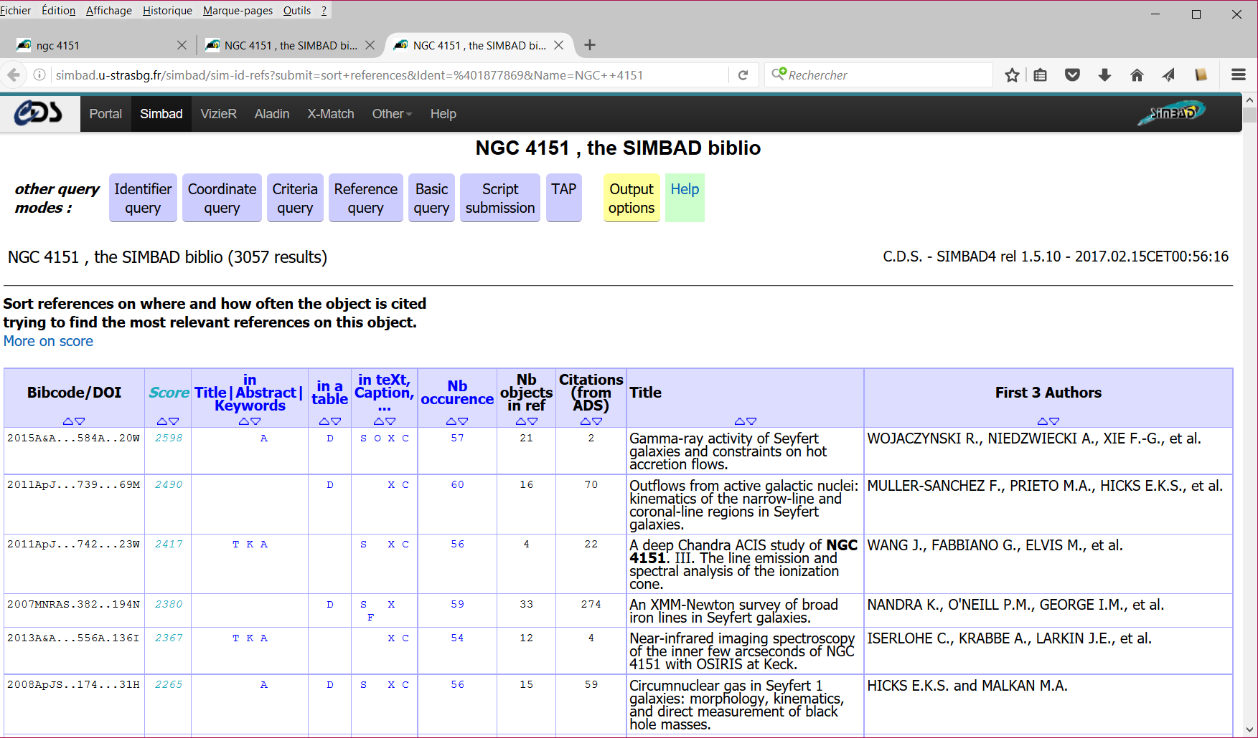
SIMBAD added value: references citing the object ⊕ sort references by relevance
6 June 2017
F. Genova, LISA VIII, Strasbourg
<number>

Slide 13
Networking and interoperability
Networking of on-line resources from 1993-4 (added-value services, journals, archives)
6 June 2017
F. Genova, LISA VIII, Strasbourg
<number>

Slide 14
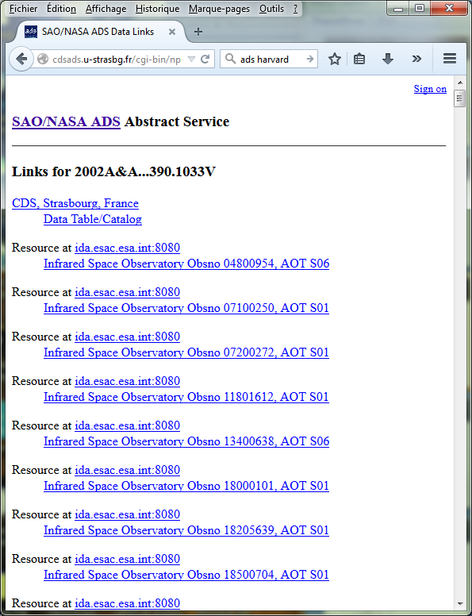
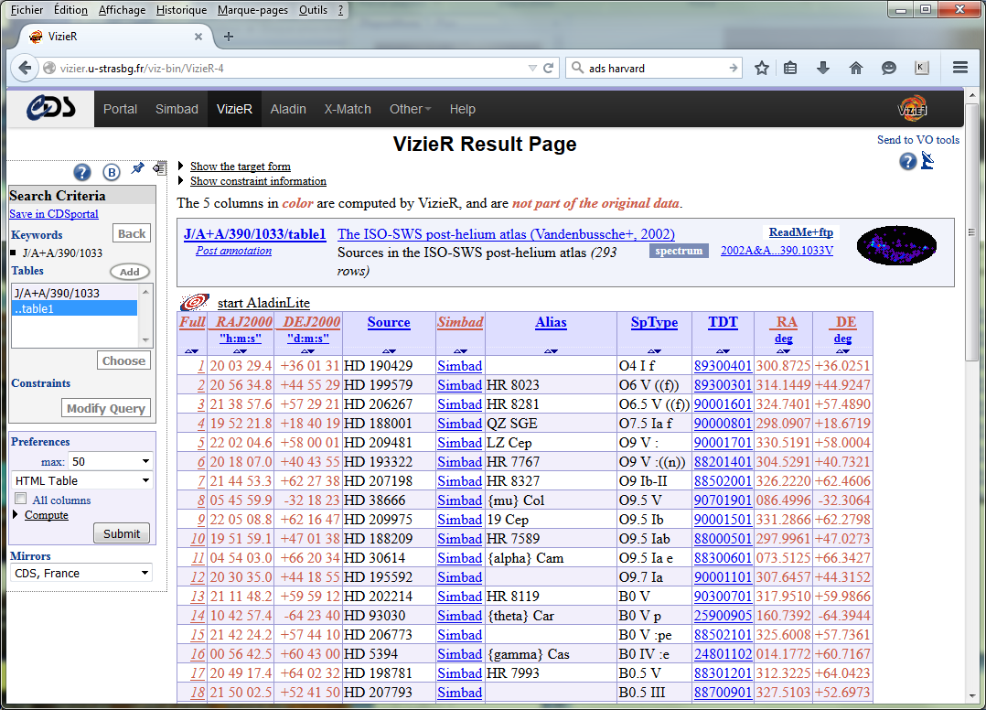
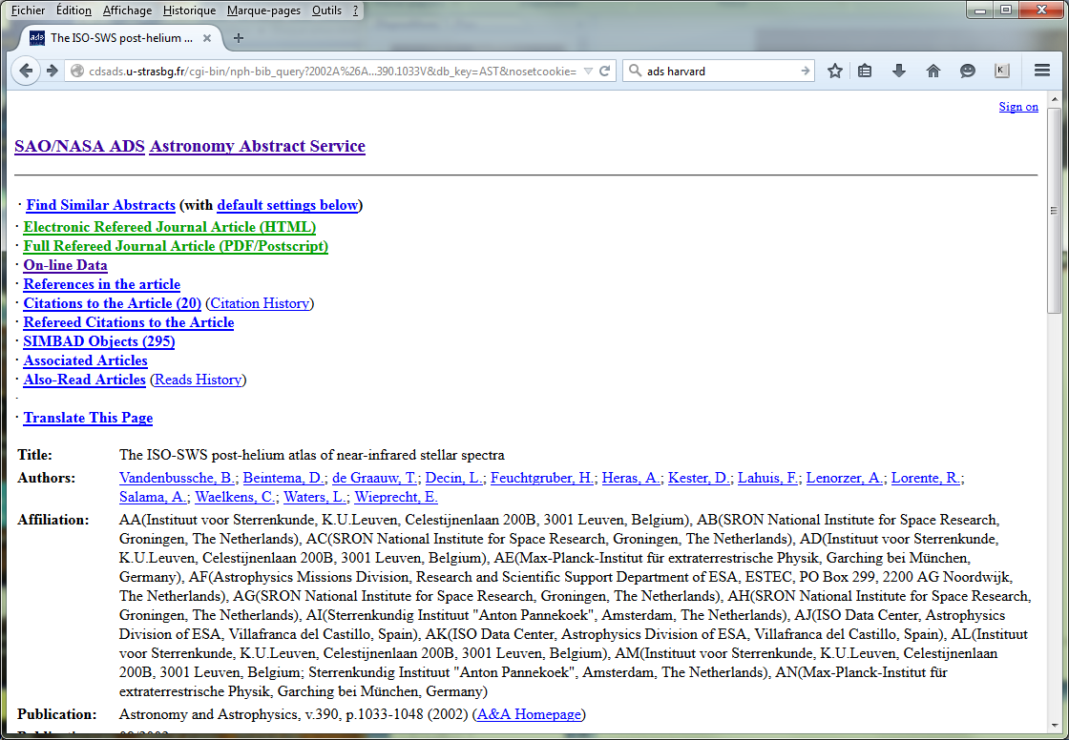
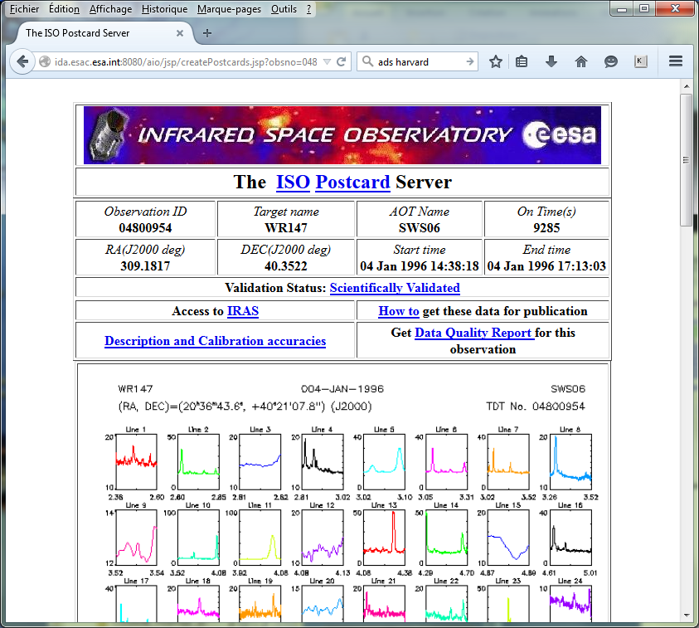
Early networking of on-line resources, still in use
6 June 2017
F. Genova, LISA VIII, Strasbourg
<number>

Slide 15
Networking and interoperability
Networking of on-line resources from 1993-4 (added-value services, journals, archives)
Seamless access to on-line data (~2000)
The astronomical Virtual Observatory
The VO framework : standards and data access tools – discover, access, use data
Standards defined by the International Virtual Observatory Alliance (IVOA)
  An alliance of national VO initiatives
  Procedure inspired from W3C
  When possible generic elements
(Registry: OAI-PMH, Vocabularies: SKOS/RDF)
6 June 2017
F. Genova, LISA VIII, Strasbourg
<number>

Slide 16
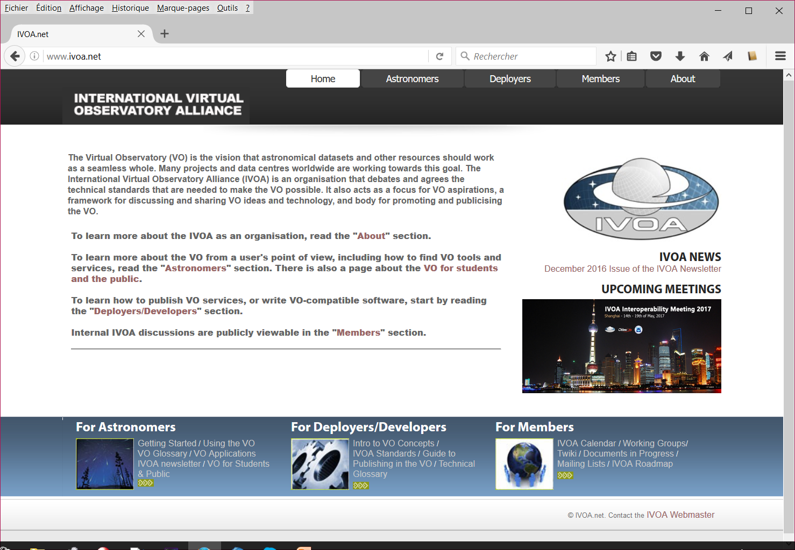

The IVOA
6 June 2017
F. Genova, LISA VIII, Strasbourg
<number>

Slide 17
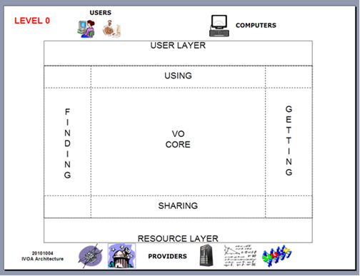
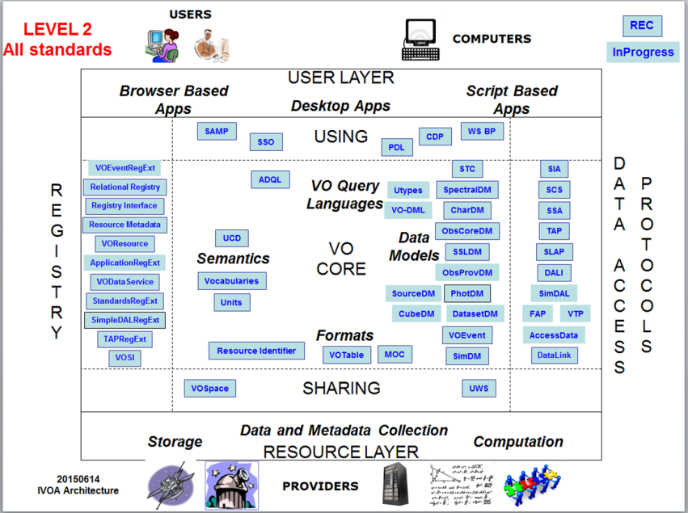
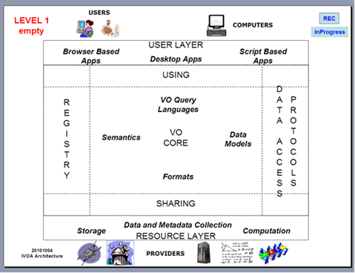
The IVOA standard framework
6 June 2017
F. Genova, LISA VIII, Strasbourg
<number>

Slide 18
An inclusive and open framework
No central point, a multi-polar world, a global endeavour
“Open” and inclusive model
  A thin interoperability layer on top of the data holdings
  Anyone can register a data service or build a tool (more than 100 “authorities” with a registered service)
The VO is invisible but used - astronomers use the services and the tools!
Not only the interoperability layer now: data providers also imbed VO building blocks in their archives and services
6 June 2017
F. Genova, LISA VIII, Strasbourg
<number>

Slide 19
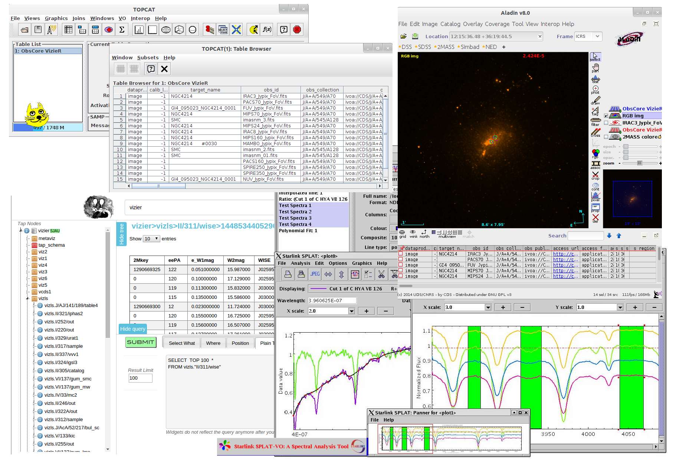
Interoperable tools and data services
6 June 2017
F. Genova, LISA VIII, Strasbourg
<number>

Slide 20
Keys for success
Key for success (science users):
  seamless access to data AND interoperable tools relevant to science needs
  High quality data and services
Keys for success (data providers):
  More visibility for their data
  No need to reinvent the wheel, people already worked and propose solutions (for data sharing but also elements of archives and services systems)
6 June 2017
F. Genova, LISA VIII, Strasbourg
<number>

Slide 21
Current status
The VO framework is operational and used
Three pillars
  Support to data providers
  Support to science users
  Technological work to update standards and tools
Genova et al. 2015
Priorities linked to the needs of the future large projects
  Multi-Dimensional data – first milestone done, May 2017
  Time domain
6 June 2017
F. Genova, LISA VIII, Strasbourg
<number>

Slide 22

Current step in Europe : large projects
ASTERICS WP4: Data Access, Discovery and interoperability (4.5 M€ on 4 years)
“Make the ESFRI and pathfinder project data available for discovery and usage by the whole astronomical community, interoperable in a homogeneous international framework, and accessible with a set of common tools.”
Fully aligned with the current
IVOA priorities
6 June 2017
F. Genova, LISA VIII, Strasbourg
<number>

Slide 23
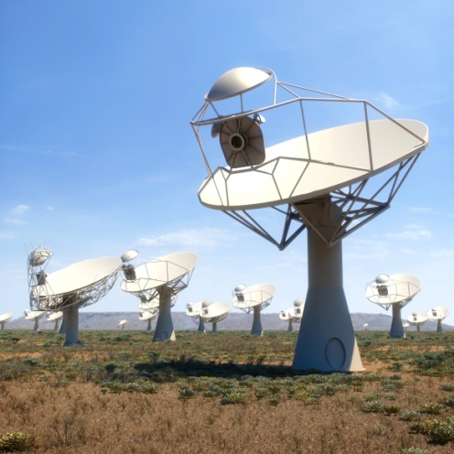
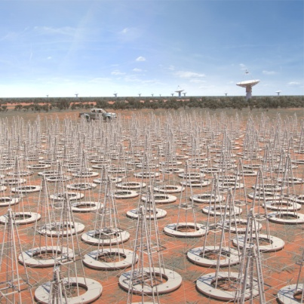
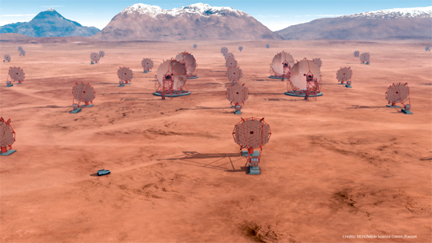
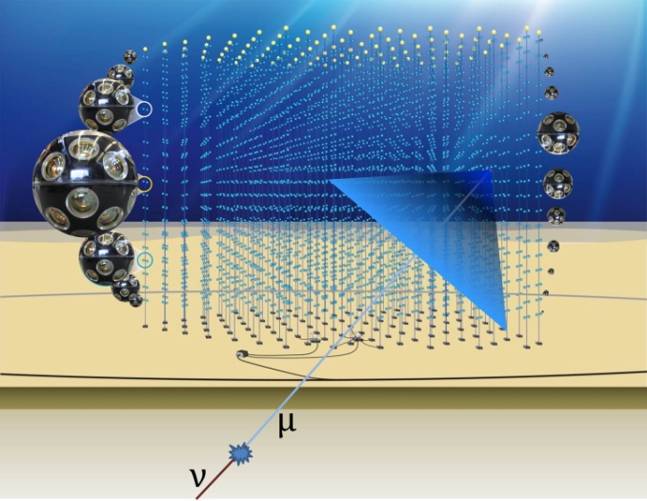
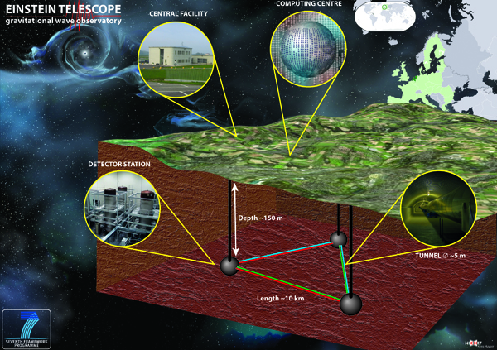

Who is involved in ASTERICS WP4
CTA
SKA
KM3Net
6 June 2017
F. Genova, LISA VIII, Strasbourg
<number>

Slide 24
Who is involved in ASTERICS WP4
Euro-VO partners, i.e. VO initiatives from France, Germany, Italy, Spain, UK
Representatives of ESFRI and pathfinders
Astronomy & Astroparticle physics, including new messengers
ESO (e-ELT) is associated to the project
ESA (ESAC) is working in close
collaboration with Euro-VO
6 June 2017
F. Genova, LISA VIII, Strasbourg
<number>

Slide 25
Cross-disciplinary aspects
Elements of the VO framework are customized and reused by « nearby » disciplines – planetary studies, the Virtual Atomic and Molecular Data Centre, also Materials sciences
The generic elements (registry of resources, vocabulary concepts) allow astronomy data infrastructure to interface with the generic data framework
6 June 2017
F. Genova, LISA VIII, Strasbourg
<number>

Slide 26
Big and Smaller Data
= Astronomical Data
Observatory archives + disciplinary data centres
Also data from publications – research results
  Agreement between CDS and the journals (started in 1993 with Astronomy & Astrophysics)
    tabular data from publications (also images, spectra, time series)
    together with catalogues from sky surveys, space missions (up to 2 billion rows)
    15 000 “catalogues”, i.e. data sets
  Homogeneous metadata describing the very heterogenous content
  Fully discoverable, usable and used
Not so much “big” and “little” data, but rather Useful, Validated and Documented data, huge diversity
6 June 2017
F. Genova, LISA VIII, Strasbourg
<number>

Slide 27
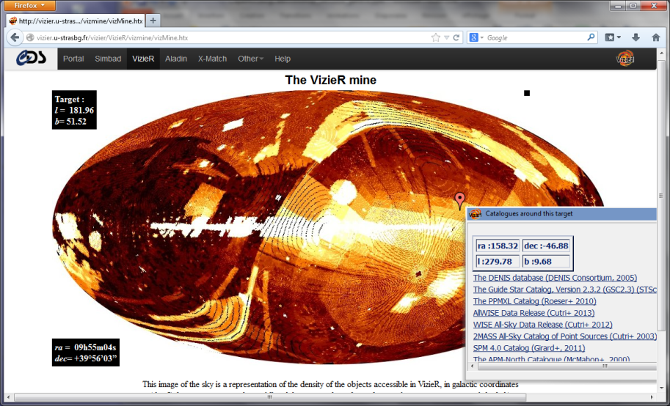
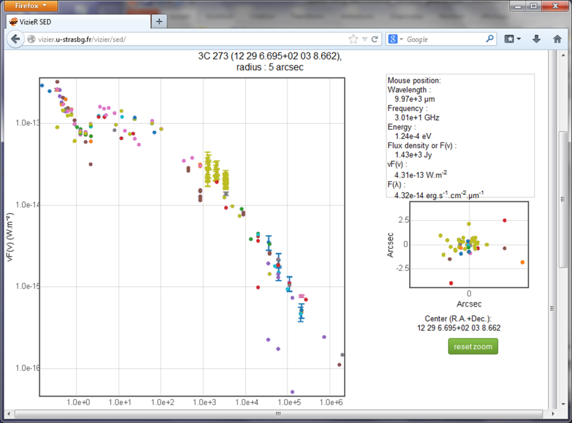
« Long Tail » data in VizieR
Data validated by a publication
Fully discoverable and usable
Together with the very large surveys
“Photometry viewer”:
Spectral points
extracted from the
collection
6 June 2017
F. Genova, LISA VIII, Strasbourg
<number>

Slide 28
VizieR associated data in VO
6 June 2017
F. Genova, LISA VIII, Strasbourg
<number>

Slide 29
Data as a research infrastructure
In Europe: Research Infrastructure Roadmaps
  European level (ESFRI) and national Roadmaps
Data/Computing/Network questions in the questionnaires of the ESFRI Roadmap and (e.g.) French National Research Infrastructure Roadmap
Some of the Infrastructures in the Roadmaps are « virtual », dealing with data, others have a strong data component
6 June 2017
F. Genova, LISA VIII, Strasbourg
<number>

Slide 30
Examples - Humanities
ESFRI : DARIAH, CLARIN
France: Huma-Num
http://www.huma-num.fr/
  Added-value services
  Disciplinary Consortia to organize communities around data sharing topics
6 June 2017
F. Genova, LISA VIII, Strasbourg
<number>

Slide 31
Example in France : Earth Sciences
Disciplinary « Poles » with participation of all the organisations involved, incl. CNES
« Inter-Pôle » technical discussions
Overarching structure being built
Strong links to European projects in the different domains
6 June 2017
F. Genova, LISA VIII, Strasbourg
<number>

Slide 32
Disciplinary Interoperability Frameworks
Session at SciDataCon 2016
Humanities/linguistics, astronomy, earth sciences, material sciences/crystallography
Commonnalities
  Must be science driven
  Defining the discipline-specific part of the interoperability standards is mandatory but difficult
  Share data AND applications
  Incentives to data sharing is a key question
  Social aspects more challenging that technical ones
Governance is more diverse, linked to the discipline organisation and history
Many sharable aspects – use the RDA for that!
6 June 2017
F. Genova, LISA VIII, Strasbourg
<number>

Slide 33
The Research Data Alliance
Founded in March 2013 by Australia, EC, and NSF and NIST
~5500 members from more ~ 120 countries
Bottom-up work to tackle all the aspects of scientific data sharing, technological as well as « sociological »
Have a look at
rd-alliance.org and join!
6 June 2017
F. Genova, LISA VIII, Strasbourg
<number>

Slide 34
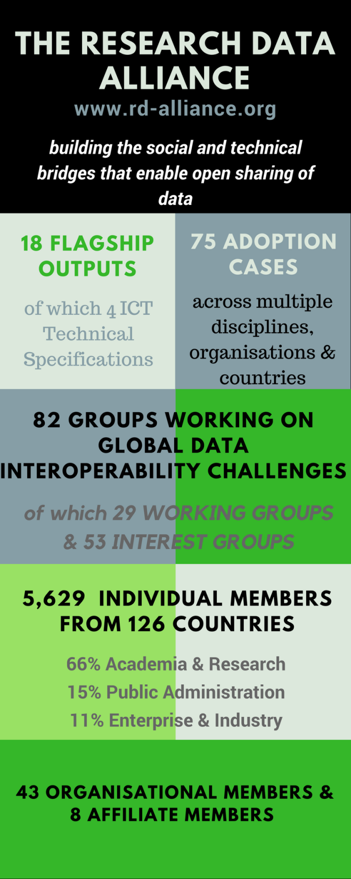
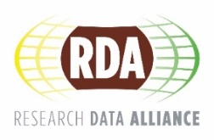
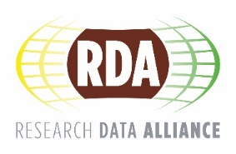
Vision
Researchers and innovators openly share data across technologies, disciplines, and countries to address the grand challenges of society.
Mission
RDA builds the social and technical bridges that enable open sharing of data.
www.rd-alliance.org
@resdatall
CC BY-SA 4.0

Slide 35
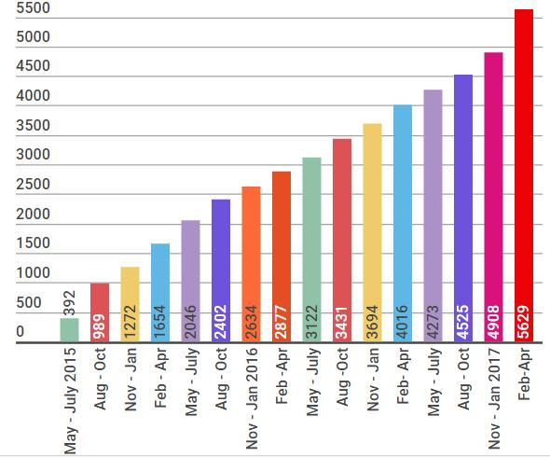
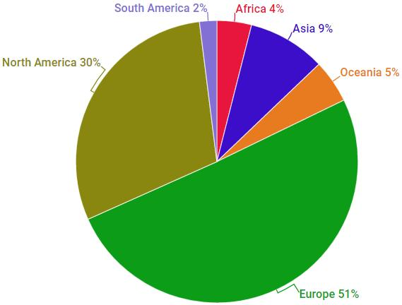
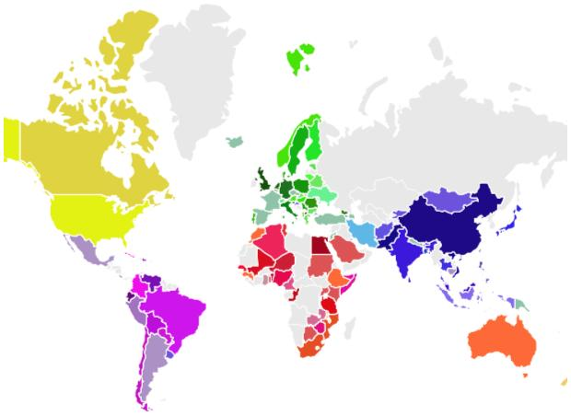
RDA worldwide growth
Total RDA community members 5629
126 Countries
rd-alliance.org/about-rda
www.rd-alliance.org
@resdatall
CC BY-SA 4.0
Notes:
Guiding Principles:
Openness
Consensus
Balance
Harmonization
Community-driven
Non-profit and technology-neutral
<number>

Slide 36
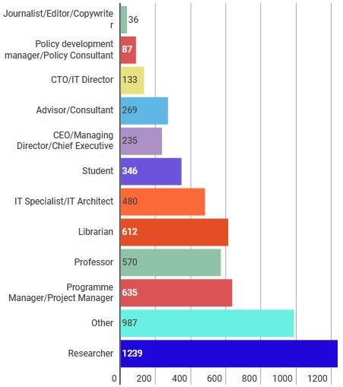
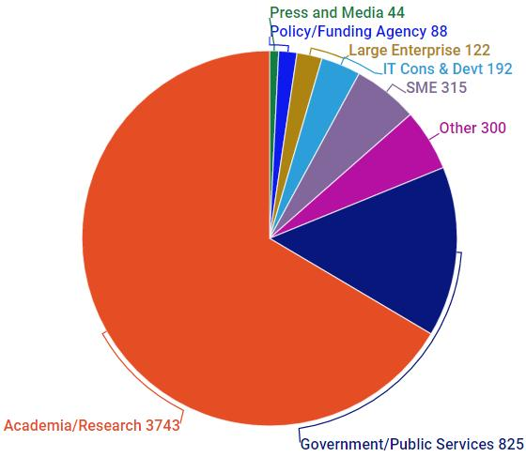
Who is RDA?
rd-alliance.org/about-rda
www.rd-alliance.org
@resdatall
CC BY-SA 4.0
Notes:
Guiding Principles:
Openness
Consensus
Balance
Harmonization
Community-driven
Non-profit and technology-neutral
<number>

Slide 37
Many topics, many participant profiles
82 Working Groups and Interest Groups on building blocks
Wide diversity of topics
  Domain science
  Community needs
  Data Referencing and sharing
  Data stewardship and services
  Base infrastructure
Data providers, librarians, researchers, project/programme managers, publishers…
International, neutral forum for discussion
Recommendations and outputs
6 June 2017
F. Genova, LISA VIII, Strasbourg
<number>

Slide 38
Among the topics of particular interest
Repository audit and certification (DSA+WDS)
The importance of data publishing and DOIs
  Dynamic data citation
  RDA/WDS Publishing Data…
    Bibliometrics
    Workflows
    Services (Scholix)
23 things: Libraries for Research Data
Disciplinary Interoperability Frameworks (including IVOA!)
6 June 2017
F. Genova, LISA VIII, Strasbourg
<number>

Slide 39
Conclusions (1)
Exciting times for scientific data sharing
Astronomy has been at the forefront
  Data is one of the discipline research infrastructures
  Global interoperability operational
Many other disciplines are moving on
The context is evolving very fast
Important to participate in initiatives such as RDA to ensure our requirements are taken into account
Trust (… certification) and data quality are essential
6 June 2017
F. Genova, LISA VIII, Strasbourg
<number>

Slide 40
Conclusions (2)
Evolving role of librarians with scientific data sharing
One of the essential profiles at CDS since the beginning (1972!)
Several level of data curation
  Disciplinary repositories – incl. local ones
  Institutional repositories
  Going beyond Dublin Core requires disciplinary knowledge
6 June 2017
F. Genova, LISA VIII, Strasbourg
<number>

Slide 41
RDA Interest (IG) & Working Groups (WG) by Focus (1)
Total 82 groups:
29 Working Groups & 53 Interest Groups
Domain Science - focused
Agrisemantics WG
BioSharing Registry WG
Fisheries Data Interoperability WG
On-Farm Data Sharing (OFDS) WG
Rice Data Interoperability WG
Wheat Data Interoperability WG
Agricultural Data IG (IGAD)
Biodiversity Data Integration IG
Chemistry Research Data IG
Digital Practices in History and Ethnography IG
Geospatial IG
Global Water Information IG
Health Data IG
Linguistics Data Interest Group
Mapping the Landscape IG
Marine Data Harmonization IG
Quality of Urban Life IG
RDA/CODATA Materials Data, Infrastructure & Interoperability IG
Research data needs of the Photon and Neutron Science community IG
Small Unmanned Aircraft Systems’ Data IG
Structural Biology IG
Weather, Climate and air quality IG
Community Needs - focused
Certification and Accreditation for Data Science Training and Education WG
RDA/CODATA Summer Schools in Data Science and Cloud Computing in the Developing World WG
Teaching TDM on Education and Skill Development WG
Archives & Records Professionals for Research Data IG
Data for Development IG
Development of Cloud Computing Capacity and Education in Developing World Research IG
Early Career and Engagement IG
Education and Training on handling of research data IG
Ethics and Social Aspects of Data IG
International Indigenous Data Sovereignty IG
rd-alliance.org/groups
www.rd-alliance.org
@resdatall
CC BY-SA 4.0

Slide 42
RDA Interest (IG) & Working Groups (WG) by Focus (2)
Total 82 groups:
29 Working Groups & 53 Interest Groups
Reference and Sharing - focused
Data Citation WG
Data Description Registry Interoperability WG
Data Security and Trust WG
Empirical Humanities Metadata WG
International Materials Resource Registries WG
Provenance Patterns WG
QoS-DataLC Definitions WG
RDA / WDS Publishing Data Bibliometrics WG
Repository Core Description WG
Research Data Collections WG
Research Data Repository Interoperability WG
Data Discovery Paradigms IG
National Data Services IG
RDA/CODATA Legal Interoperability IG
Reproducibility IG
Partnership Groups
RDA / TDWG Metadata Standards for attribution of physical and digital collections stewardship WG
RDA/WDS Scholarly Link Exchange Working Group
ELIXIR Bridging Force IG
RDA/NISO Privacy Implications of Research Data Sets IG
RDA/WDS Publishing Data IG
rd-alliance.org/groups
www.rd-alliance.org
@resdatall
CC BY-SA 4.0

Slide 43
RDA Interest (IG) & Working Groups (WG) by Focus (3)
Total 82 groups:
29 Working Groups & 53 Interest Groups
Data Stewardship and Services – focused
Brokering Framework WG
WDS/RDA Assessment of Data Fitness for Use WG
RDA / WDS Publishing Data Workflows WG
Active Data Management Plans IG
Data in Context IG
Data Rescue IG
Data Versioning IG
Domain Repositories IG
Libraries for Research Data IG
Long tail of research data IG
Preservation e-Infrastructure IG
Preservation Tools, Techniques, and Policies IG
RDA/WDS Certification of Digital Repositories IG
RDA/WDS Publishing Data Cost Recovery for Data Centres IG
Repository Platforms for Research Data IG
Research Data Provenance IG
Virtual Research Environments IG
Base Infrastructure – focused
Array Database Assessment WG
Data Type Registries WG
Metadata Standards Catalog WG
PID Kernel Information WG
Data Fabric IG
Data Foundations and Terminology IG
Big Data IG
Brokering IG
Federated Identity Management IG
Metadata IG
PID IG
Vocabulary Services IG
rd-alliance.org/groups
www.rd-alliance.org
@resdatall
CC BY-SA 4.0

